Slide 1
Body fluids :
Dr.Bushra Zulfiqar
Lecturer Physiology Department,
DIKIOHS,DUHS.

Slide 2
Learning objectives:
Understand the Importance of Body Fluids
Identify the Different Compartments of Body Fluids
Describe the Composition of Body Fluids
Explain Fluid and Electrolyte Balance Mechanisms
Examine the Movement of Fluids Between Compartments

Slide 3
Overview:
- Body fluids are essential for maintaining homeostasis.
- They make up about 60% of total body weight in adults.
- Body fluids are categorized into two main compartments: intracellular and extracellular.

Slide 4
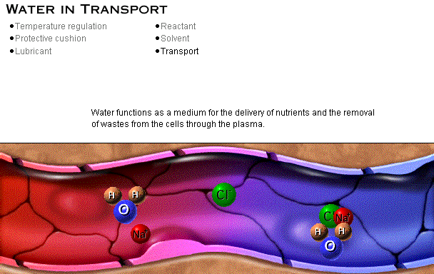
Roles of Water

Slide 5
Barriers separate ICF, interstitial fluid and plasma
Plasma membrane
    Separates ICF from surrounding interstitial fluid
Blood vessel wall
    Separate interstitial fluid from plasma

Slide 6
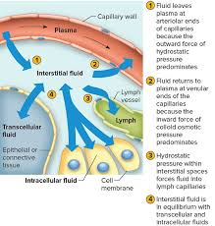
Plasma
Description: The liquid component of blood.
Volume:Approximately 3 liters in a 70kg adult.
Function: Transport of nutrient

Slide 7
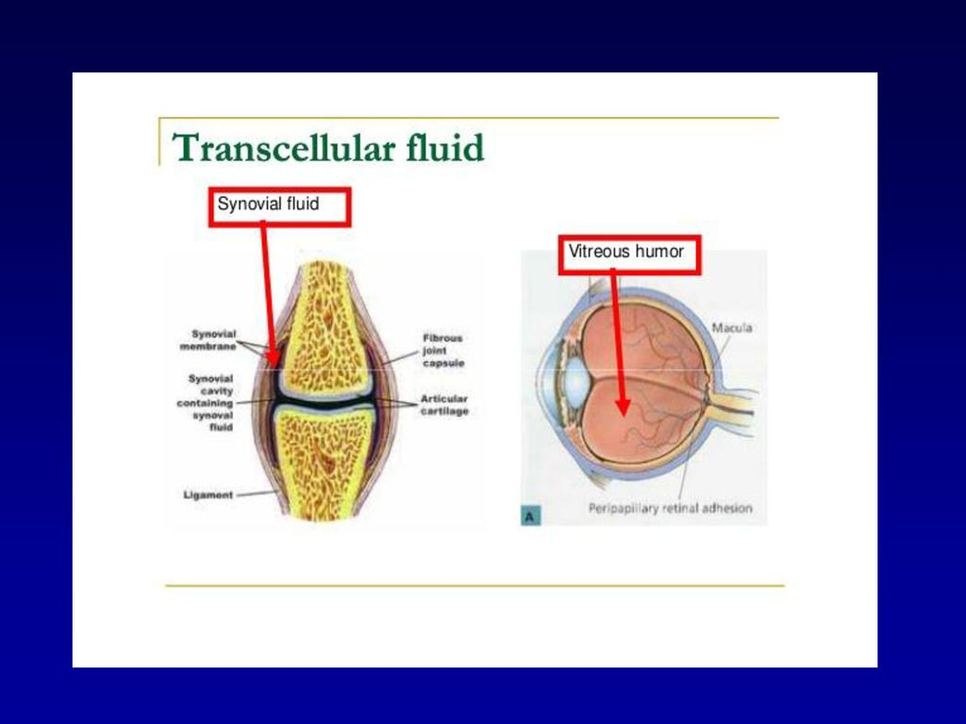
Transcellular Fluid
Description: Fluid in specific compartments like cerebrospinal fluid, synovial fluid, etc.
Examples: Cerebrospinal fluid, synovial fluid, aqueous humor.
Function: lubricates the organ in which it is present.

Slide 8
Specialized Fluids of the Body
Lymph
Milk
Cerebrospinal fluid
Amniotic fluid
Aqueous humor
Sweat
Tears

Slide 9
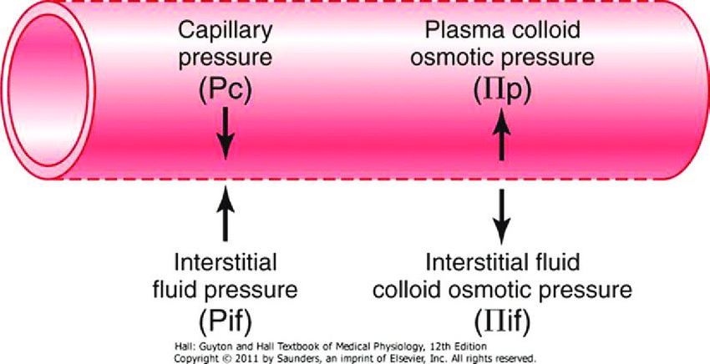

Slide 10
Regulation of Body Fluids:
Kidneys and Fluid Balance:
Kidneys regulate the volume and composition of body fluids.
Renal function: Filtration, reabsorption, secretion.
Thirst Mechanism:
Controlled by hypothalamus in response to changes in plasma osmolarity or volume.

Slide 11

Fluid Imbalance Disorders
Dehydration:
-Occurs when body loses more water than it takes in.
-Can be caused by excessive sweating, diarrhea, or inadequate fluid intake.

Slide 12

Fluid Imbalance Disorders
Edema:
Excess fluid accumulation in the interstitial space.
Causes: heart failure, kidney disease, liver cirrhosis

Slide 13
METHODS OF MEASUREMENTS
INDIRECT METHOD –
INDICATOR (DYE) DILUTION TECHNIQUE
PRINCIPLE
  YOU HAVE TO SELECT A SUITABLE DYE OR RADIO-ISOTOPE
V= VOLUME OF FLUID
A= TOTAL AMOUNT OF DYE USED
E= AMOUNT OF DYE EXCRETED OR LOST .
C= CONCENTRATION
FORMULA
V=A-E/C

